Slide 1

What service will it provide?
How does it interact with users and data?
What is our web service?
Who would benefit from it?
Web Service – Task Manager
Bernacchia Alessia
Sergio Fernandez Diz
Why could it be useful?
What problems does it solve?
Notes:
What is a web service briefly, gitlab idea

Slide 2

BACKEND
CLIENT
What is our web service?
How does it interact with users and data?
App
(routes)
library
What service will it provide?
HTTP requests
Who would benefit from it?
Why could it be useful?
service
What problems does it solve?
demo
database
Notes:
While small teams can easily manage tasks informally, as projects grow in size and complexity, the need for structured task tracking tools becomes critical and there is an increasing need for coordination and clarity in project workflows, especially within teams.
fast, and user-friendly web service can greatly improve project transparency and individual accountability.

Slide 3
BACKEND
CLIENT
Problem
Approach
Service
App
(routes)
library
What service will it provide?
Who would benefit from it?
Why could it be useful?
How does it interact with users and data?
What is our web service?
data persistence
ask queries to db
retrieve responses
permit large usage
data storage
ask queries to db
API
export package
SQLite
Flask App
Python classes
wheel
HTTP requests
What problems does it solve?
service
demo
database
3
Notes:
While small teams can easily manage tasks informally, as projects grow in size and complexity, the need for structured task tracking tools becomes critical and there is an increasing need for coordination and clarity in project workflows, especially within teams.
fast, and user-friendly web service can greatly improve project transparency and individual accountability.

Slide 4
BACKEND
CLIENT
Problem
Approach
Service
App
(routes)
library
What service will it provide?
Who would benefit from it?
Why could it be useful?
How does it interact with users and data?
What is our web service?
data persistence
ask queries to db
retrieve responses
permit large usage
data storage
ask queries to db
API
export package
SQLite
Flask App
Python classes
wheel
HTTP requests
What problems does it solve?
service
demo
database

Slide 5

Backend
Problem
Approach
Service
data persistence
ask queries to db
retrieve responses
permit large usage
data storage
ask queries to db
API
export package
SQLite
Flask App
Python classes
wheel
lightweight
serverless database
widely used for small-scale
Notes:
SQLite is a lightweight, serverless database engine widely used for prototyping and small-scale applications.

Slide 6
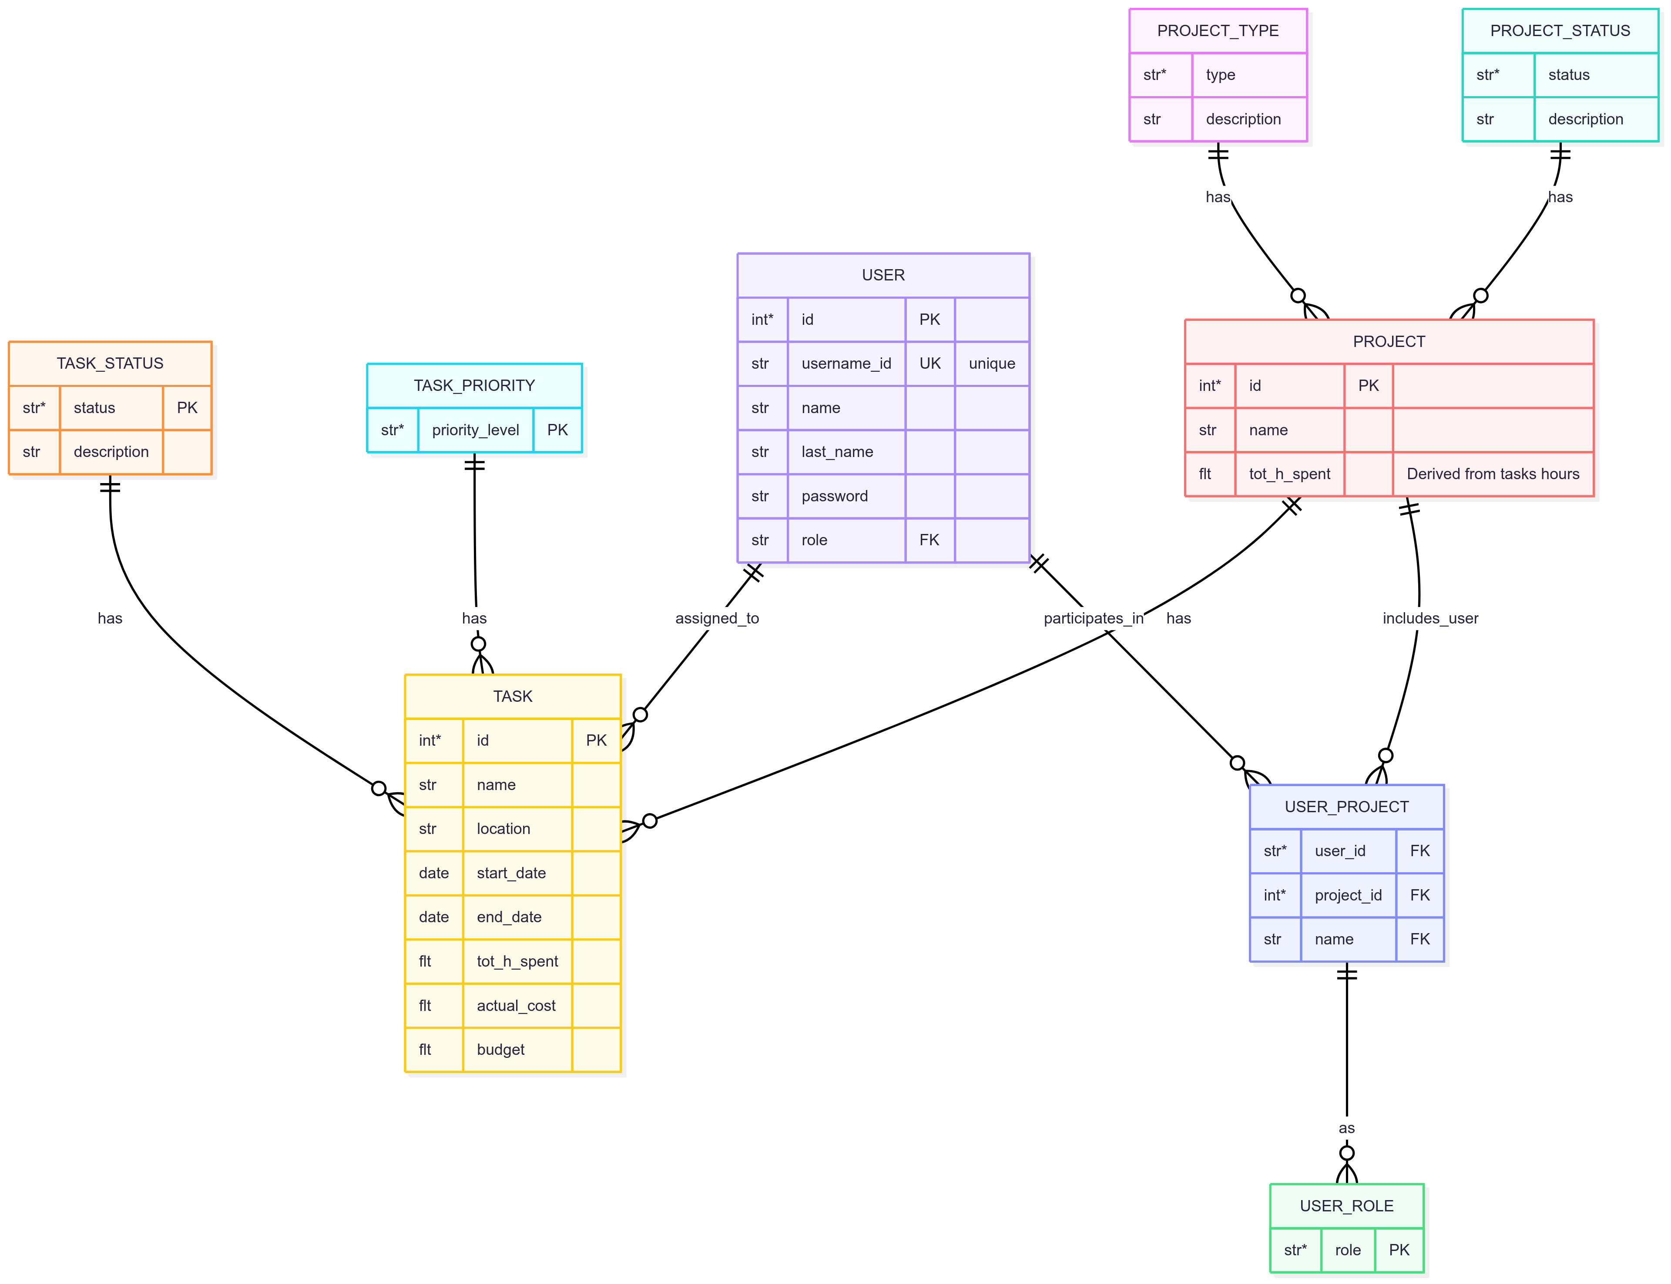
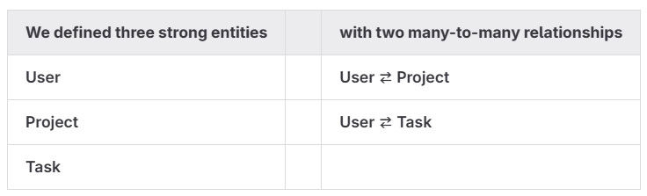
Approach
Service
data storage
ask queries to db
API
export package
SQLite
Flask App
Python classes
wheel
lightweight
serverless database
widely used for small-scale
Backend

Slide 7
Approach
Service
data storage
ask queries to db
API
export package
SQLite
Flask App
Python classes
wheel
lightweight
serverless database
widely used for small-scale
Backend

Slide 8


Backend
Approach
Service
data storage
ask queries to db
API
export package
SQLite
Flask App
Python classes
wheel
REST ful backend
easy integrable in Python
flexible
extensible
Client
modular design
object oriented
reusable
for wheel
versioned
easy to distribute
Notes:
Flask is a Python micro-framework ideal for building web services and REST APIs.

Slide 9
Backend
Client
Approach
Service
modular design
object oriented
reusable
for wheel
versioned
easy to distribute
data storage
ask queries to db
API
export package
SQLite
Flask App
Python classes
wheel

Slide 10
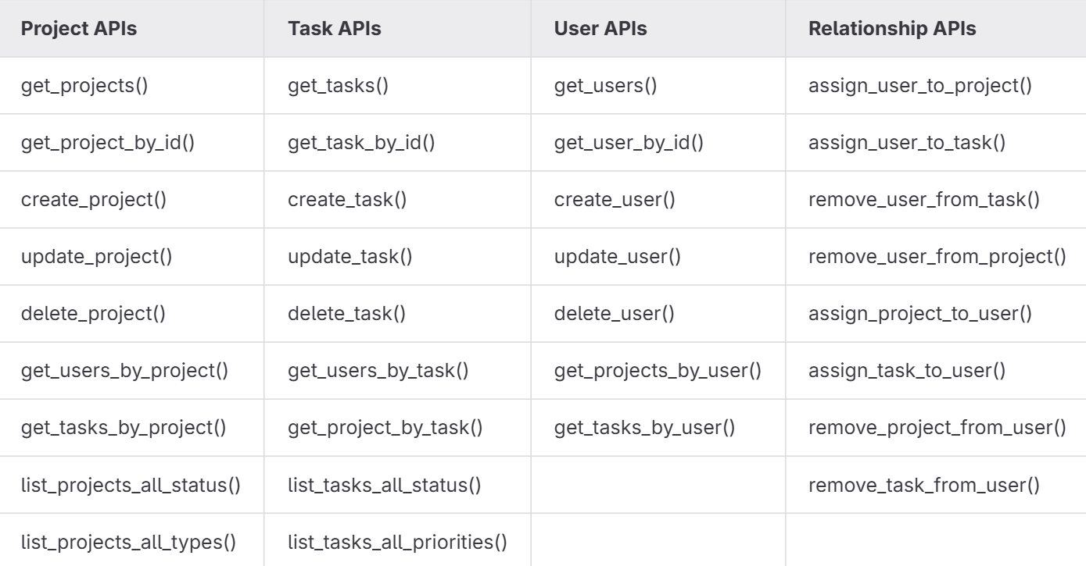
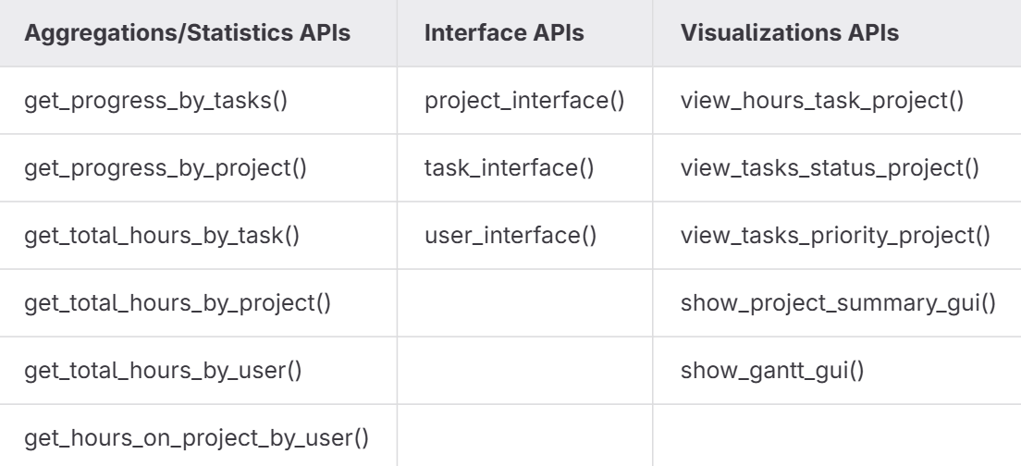
Problem
Approach
Service
data persistence
ask queries to db
retrieve responses
permit large usage
data storage
ask queries to db
API
export package
SQLite
Flask App
Python classes
wheel
Backend
Client
modular design
object oriented
reusable
for wheel
versioned
easy to distribute

Slide 11
Problem
Approach
Service
data persistence
ask queries to db
retrieve responses
permit large usage
data storage
ask queries to db
API
export package
SQLite
Flask App
Python classes
wheel
Backend
Client
modular design
Object oriented
reusable
for wheel
versioned
easy to distribute
Notes:
Interaction test in the backend and unit test in the classes (modules) in the client

Slide 12
Web Service – Task Manager
Bernacchia Alessia
Sergio Fernandez Diz

Slide 13
Introduction
Cosa
Perché
spiegazione database

Slide 14
Approach to the problem
Data storage
Backend
API
Distribution

Slide 15

Data Storage
Perché SQLite -> abbiamo relazioni tra classi quindi SQL o SQLite decidiamo SQLite perché è più veloce e apposta per database non troppo grandi
Spiegare Flask aplication
Far vedere ER diagram

Slide 16
Backend
Spiegare cosa gestisce, routes per le CRUD,service come mai li abbiamo divisi, spiegare i test per cosa sono fatti, quanti sono
Spiegare dataset piccolo per i test
Far vedere ER diagram
Testato con postman inizialmente
Test di tipo input invalidation error handling

Slide 17
API
Spiegare a cosa serve
La key difference che è il fatto che client usa object oriented mentre backend usa le classi SQL,
3 Moduli
Spiegare che include tutte le funzioni:
CRUD api
Aggregations
Statistics
Interface

Slide 18
Distribution
Spiegare che abbiamo fatto la wheel, cosa abbiamo impachettato
E introdurre la demo, spiegare che è fuori sia da client che da backend e che utilizza le funzioni prese dalla library e non dalla cartella

